Slide 1
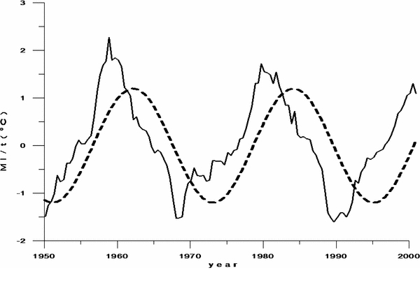
Figure 5 from Correlation between the 22-year Solar Magnetic Cycle and the 22-year Quasicycle in the Earth's Atmospheric Temperature
Weizheng Qu et al. 2012 AJ 144 6 doi:10.1088/0004-6256/144/1/6
Information:
Thank you for downloading this PowerPoint slide from The Astronomical Journal. This slide was designed to be edited; you can:
- Remove components (including this text box!)
- Resize components
- Apply a style or theme
- Please remember to include the original article citation information.

